Slide 1
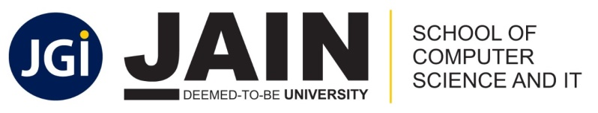
School of Computer Science & IT Department of BCA
COMPUTER NETWORKS(23BCA3C02)
MODULE 4: Transport Layer

Slide 2

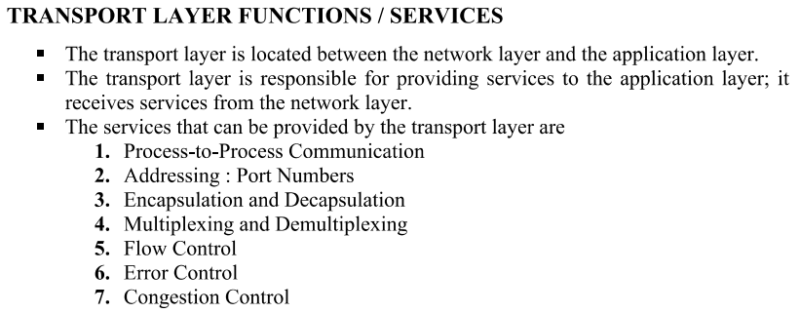
write the functions or services of Transport Layer?

Slide 3
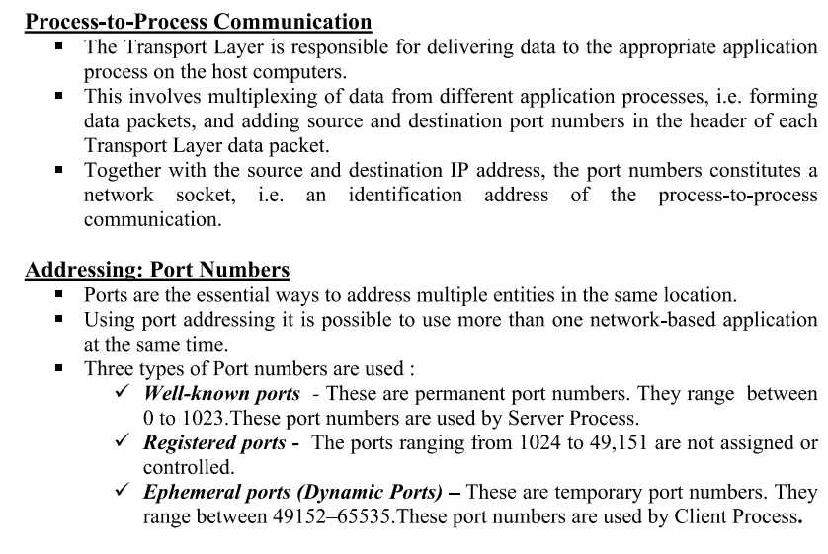

Slide 4
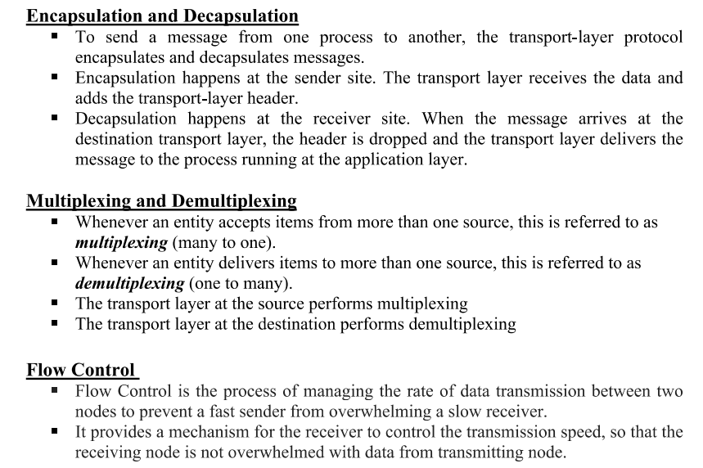

Slide 5
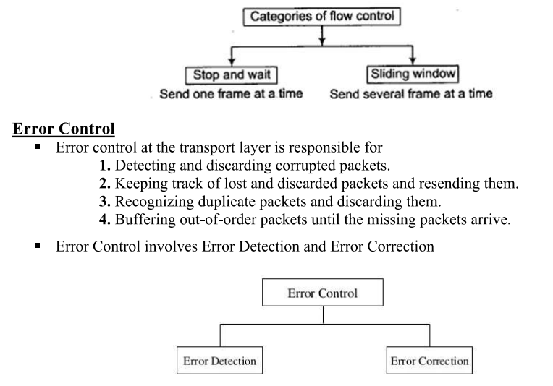

Slide 6
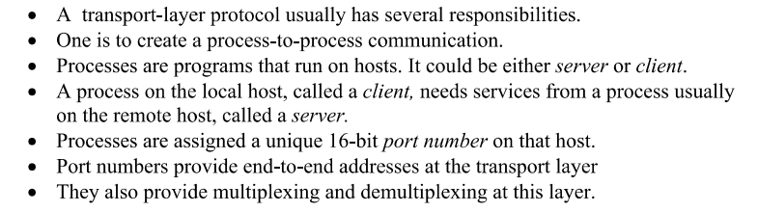
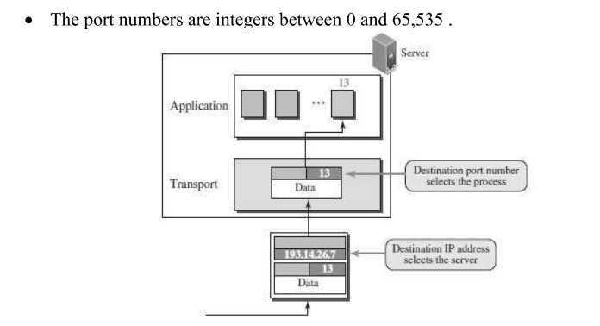
2. Define port numbers and Explain?

Slide 7
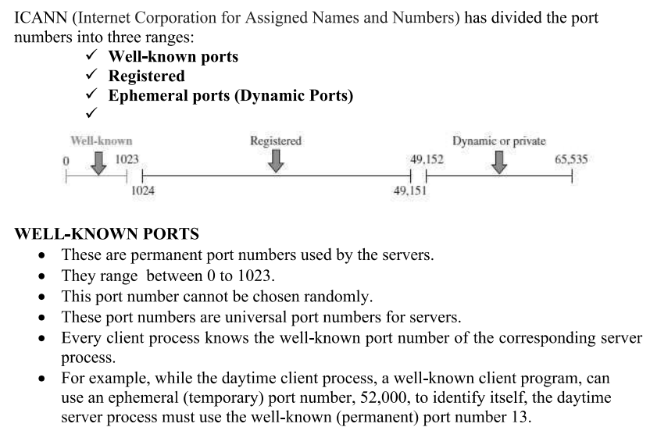


Slide 8
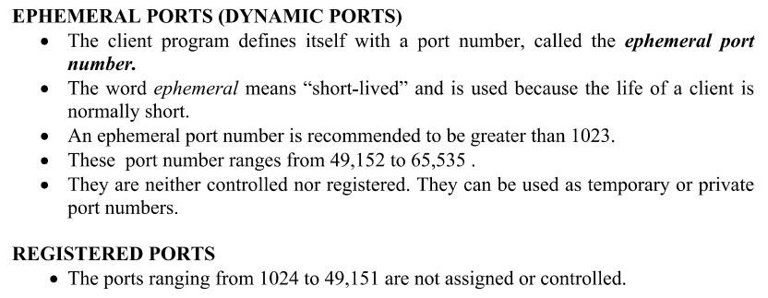

Slide 9
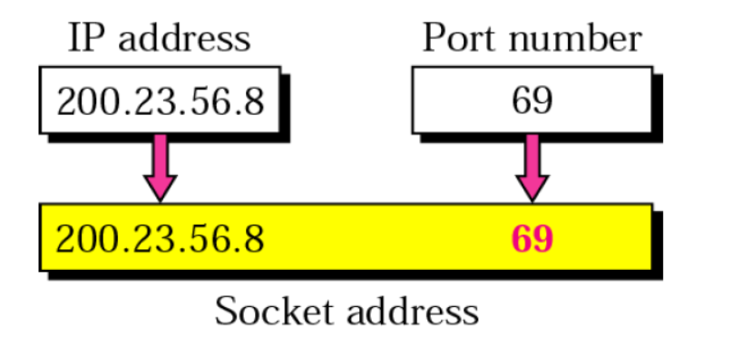
3. Define Socket addresses?
A transport-layer protocol in the TCP suite needs both the IP address and the port number, at each end, to make a connection. The combination of an IP address and a port number is called a socket address.
The client socket address defines the client process uniquely just as the server socket address defines the server process uniquely as shown in Figure.
To use the services of transport layer in the Internet, we need a pair of socket addresses: the client socket address and the server socket address.
These four pieces of information are part of the network-layer packet header and the transport-layer packet header. The first header contains the IP addresses; the second header contains the port numbers.

Slide 10
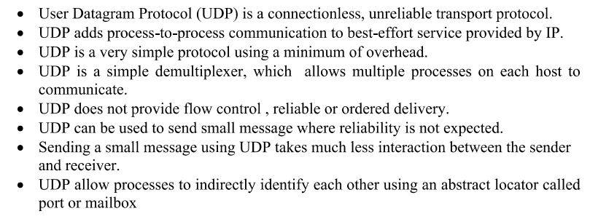
4. Write about the User Datagram Protocol and UDP packet ?

Slide 11
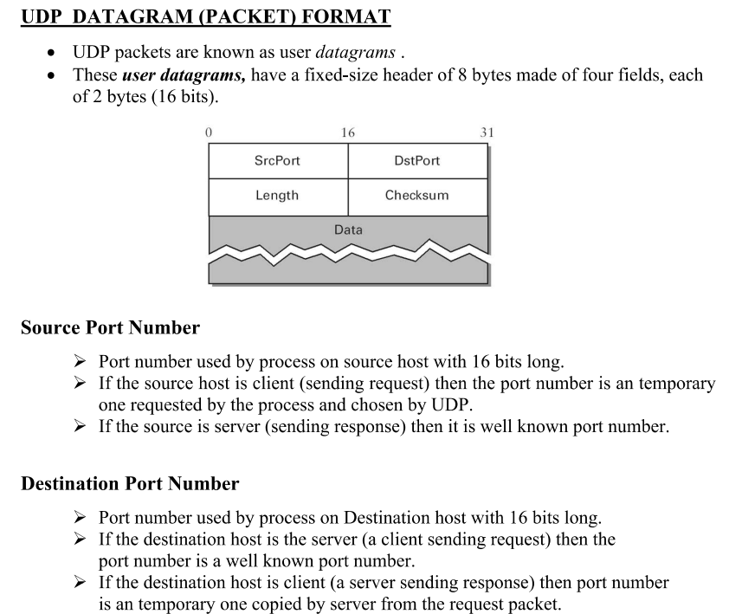

Slide 12
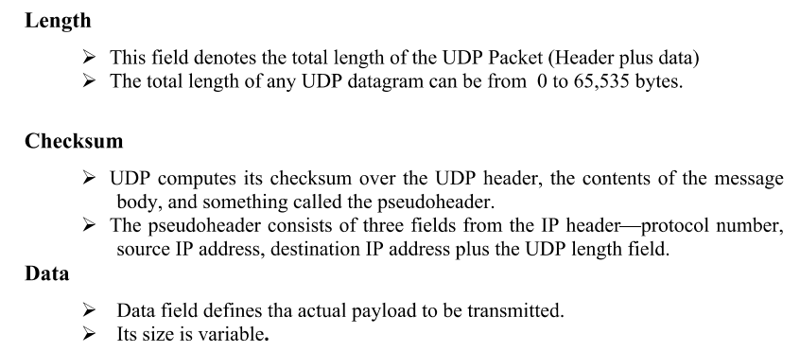

Slide 13
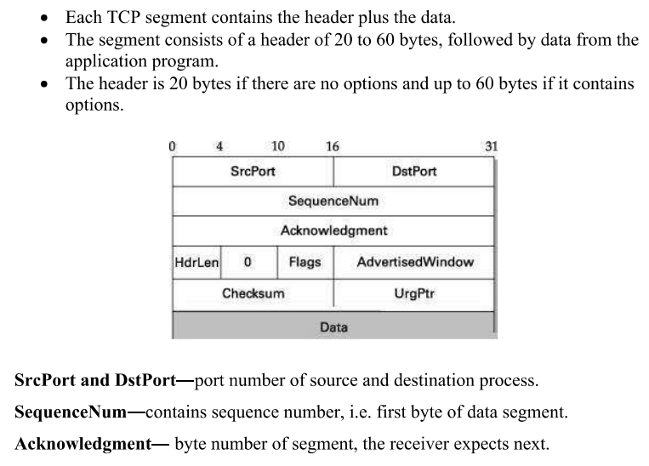
5. Write about TCP Packet format?

Slide 14
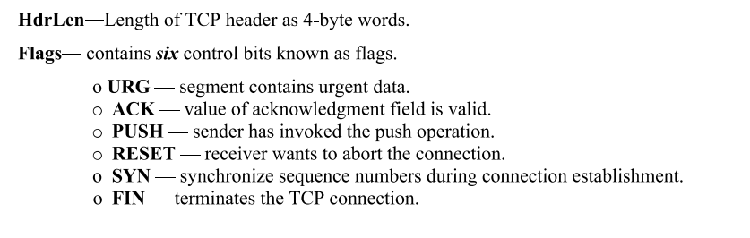
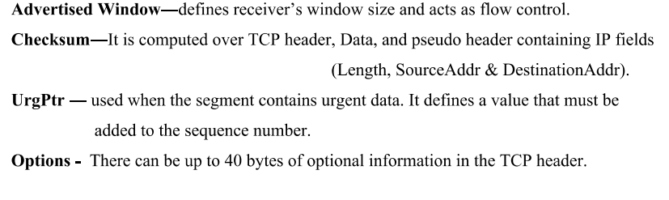

Slide 15
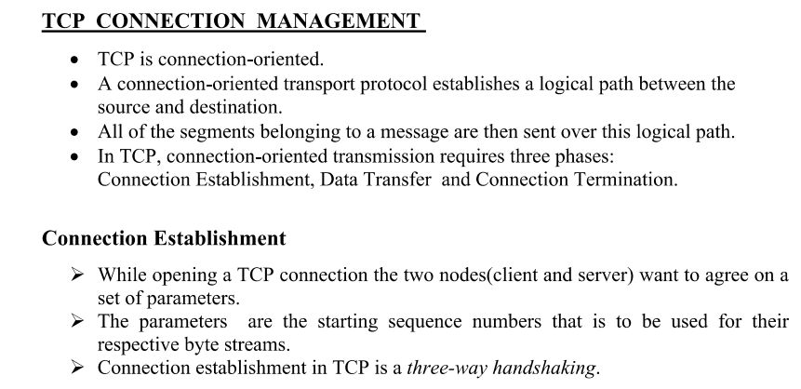
6. Write about TCP connection management?(or explain about Tcp connection establishment and connection termination? Or Explain Handshaking in TCP?)

Slide 16
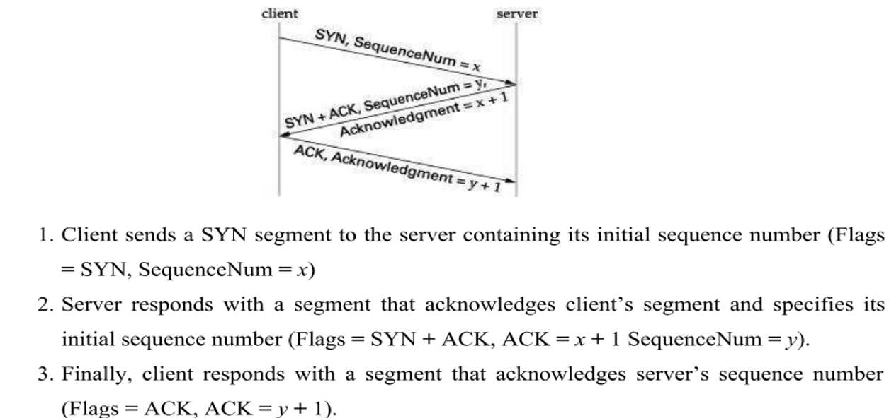

Slide 17
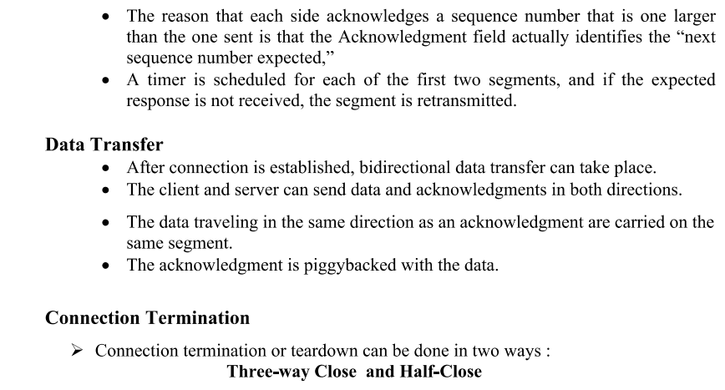

Slide 18
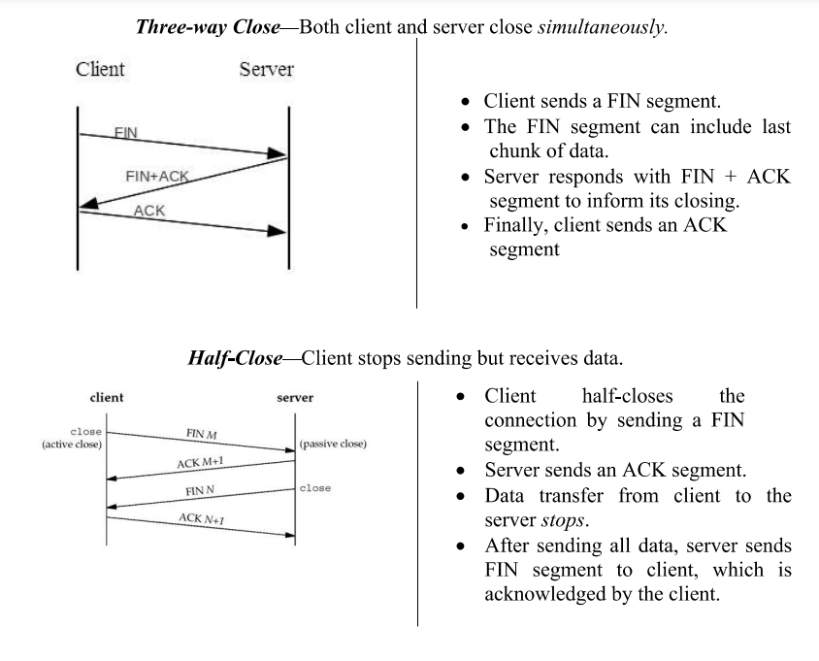

Slide 19
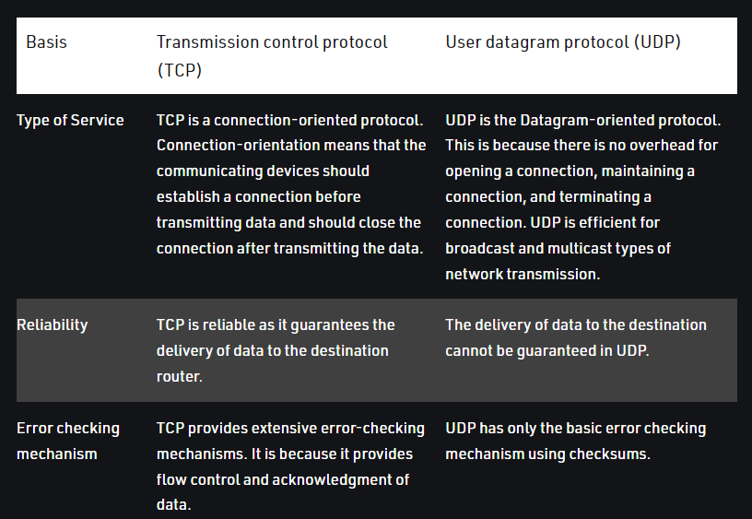
7. Write the differences between UDP and TCP?

Slide 20
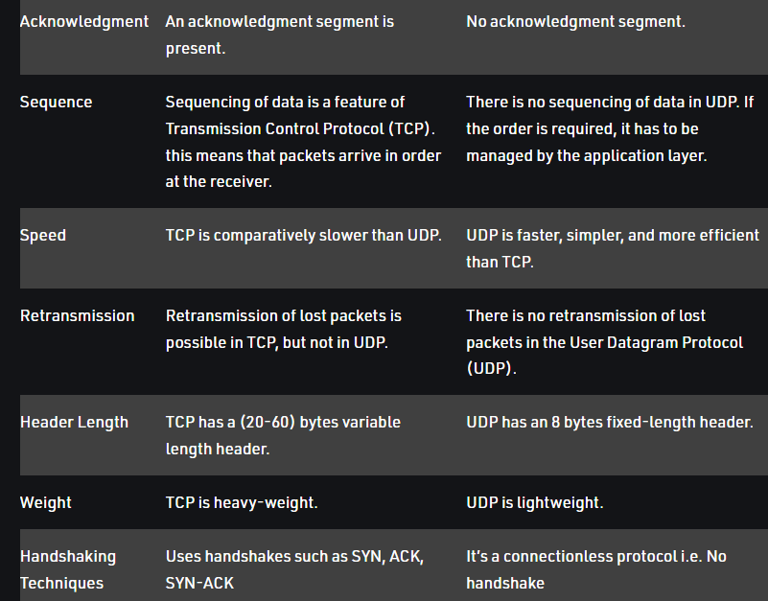

Slide 21
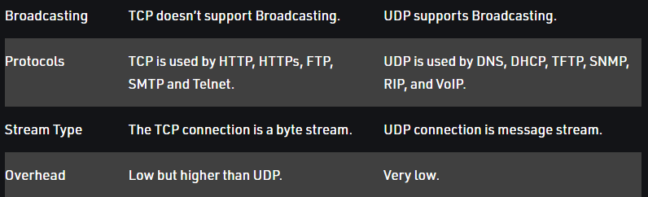

Slide 22
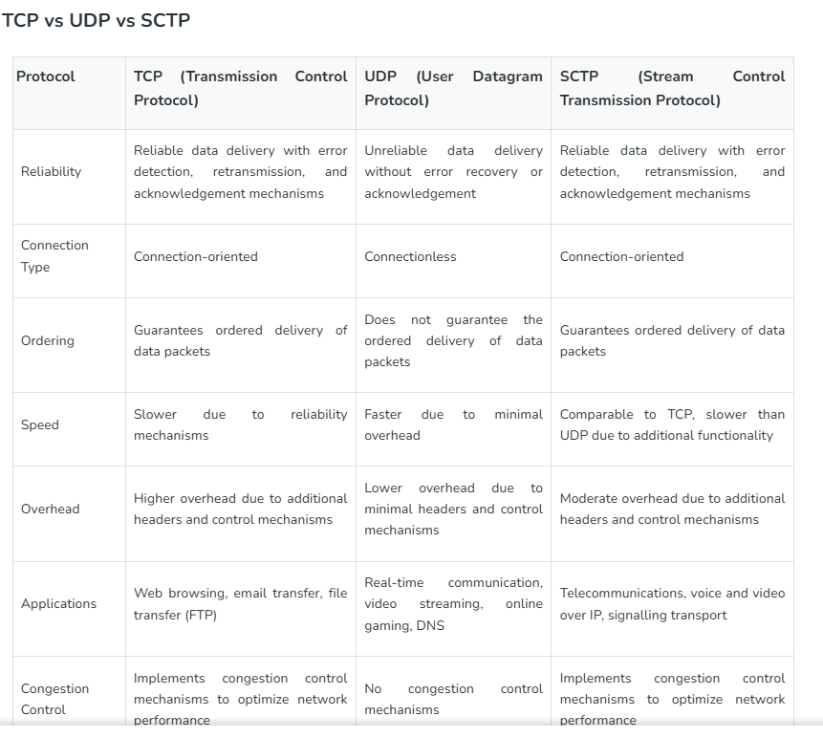
8.Compare tcp,udp,sctp ?

Slide 23
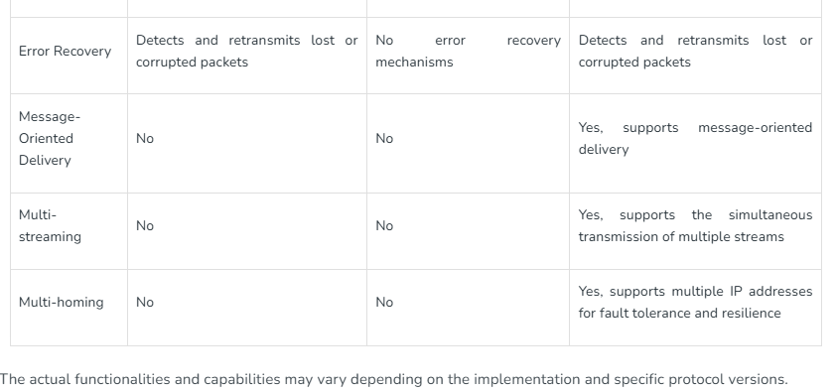

Slide 24
9.Explain SCTP and its functions?
SCTP stands for Stream Control Transmission Protocol. It is a new reliable, messageoriented transport layer protocol. SCTP, however, is mostly designed for Internet applications that have recently been introduced. These new applications, such as IUA (ISDN over IP), M2UA and M3UA (telephony signaling), H.248 (media gateway control), H.323 (IP telephony), and SIP (IP telephony), etc.
SCTP combines the best features of UDP and TCP. SCTP is a reliable message-oriented protocol. It preserves the message boundaries, and at the same time, detects lost data, duplicate data, and out-of-order data. It also has congestion control and flows control mechanisms.
Features of SCTP
There are various features of SCTP, which are as follows −
1.Transmission Sequence Number
The unit of data in TCP is a byte. Data transfer in TCP is controlled by numbering bytes by using a sequence number. On the other hand, the unit of data in SCTP is a DATA chunk that may or may not have a one-to-one relationship with the message coming from the process because of fragmentation.

Slide 25
2.Stream Identifier
In TCP, there is only one stream in each connection. In SCTP, there may be several streams in each association. Each stream in SCTP needs to be identified by using a stream identifier (SI). Each data chunk must carry the SI in its header so that when it arrives at the destination, it can be properly placed in its stream. The 51 is a 16-bit number starting from O.
3.Stream Sequence Number
When a data chunk arrives at the destination SCTP, it is delivered to the appropriate stream and in the proper order. This means that, in addition to an SI, SCTP defines each data chunk in each stream with a stream sequence number (SSN).
4.Packets
In TCP, a segment carries data and control information. Data is carried as a collection of bytes; control information is defined by six control flags in the header. The design of SCTP is totally different: data is carried as data chunks; control information is carried as control chunks.
5.Flow Control
Like TCP, SCTP implements flow control to avoid overwhelming the receiver.
6.Error Control
Like TCP, SCTP implements error control to provide reliability. TSN numbers and acknowledgement numbers are used for error control.
7.Congestion Control
Like TCP, SCTP implements congestion control to determine how many data chunks can be injected into the network.

Slide 26
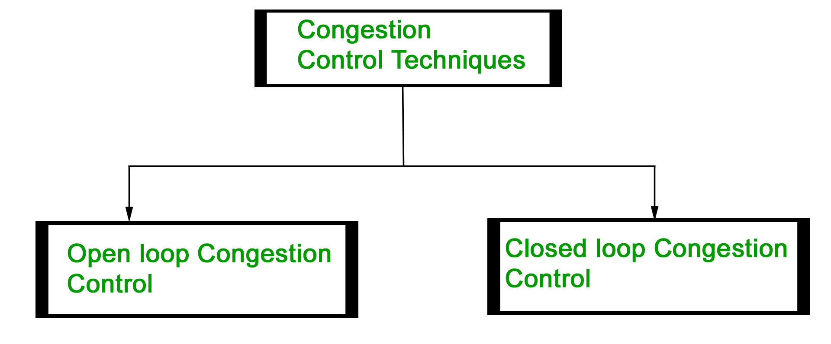
10.Explain Congestion Control techniques in Computer Networks?
Congestion control refers to the techniques used to control or prevent congestion. Congestion control techniques can be broadly classified into two categories:

Slide 27
Open Loop Congestion Control
Open loop congestion control policies are applied to prevent congestion before it happens. The congestion control is handled either by the source or the destination.
Policies adopted by open loop congestion control – Retransmission Policy : It is the policy in which retransmission of the packets are taken care of. If the sender feels that a sent packet is lost or corrupted, the packet needs to be retransmitted. This transmission may increase the congestion in the network. To prevent congestion, retransmission timers must be designed to prevent congestion and also able to optimize efficiency.
Window Policy : The type of window at the sender’s side may also affect the congestion. Several packets in the Go-back-n window are re-sent, although some packets may be received successfully at the receiver side. This duplication may increase the congestion in the network and make it worse. Therefore, Selective repeat window should be adopted as it sends the specific packet that may have been lost.
Discarding Policy : A good discarding policy adopted by the routers is that the routers may prevent congestion and at the same time partially discard the corrupted or less sensitive packages and also be able to maintain the quality of a message. In case of audio file transmission, routers can discard less sensitive packets to prevent congestion and also maintain the quality of the audio file.
Acknowledgment Policy : Since acknowledgements are also the part of the load in the network, the acknowledgment policy imposed by the receiver may also affect congestion. Several approaches can be used to prevent congestion related to acknowledgment. The receiver should send acknowledgement for N packets rather than sending acknowledgement for a single packet. The receiver should send an acknowledgment only if it has to send a packet or a timer expires.

Slide 28
Admission Policy : In admission policy a mechanism should be used to prevent congestion. Switches in a flow should first check the resource requirement of a network flow before transmitting it further. If there is a chance of a congestion or there is a congestion in the network, router should deny establishing a virtual network connection to prevent further congestion.
All the above policies are adopted to prevent congestion before it happens in the network. Congestion control ensures that a network can handle traffic efficiently without data loss.
Closed Loop Congestion Control
Closed loop congestion control techniques are used to treat or alleviate congestion after it happens. Several techniques are used by different protocols; some of them are:
1. Backpressure : Backpressure is a technique in which a congested node stops receiving packets from upstream node. This may cause the upstream node or nodes to become congested and reject receiving data from above nodes. Backpressure is a node-to-node congestion control technique that propagate in the opposite direction of data flow. The backpressure technique can be applied only to virtual circuit where each node has information of its above upstream node.

Slide 29
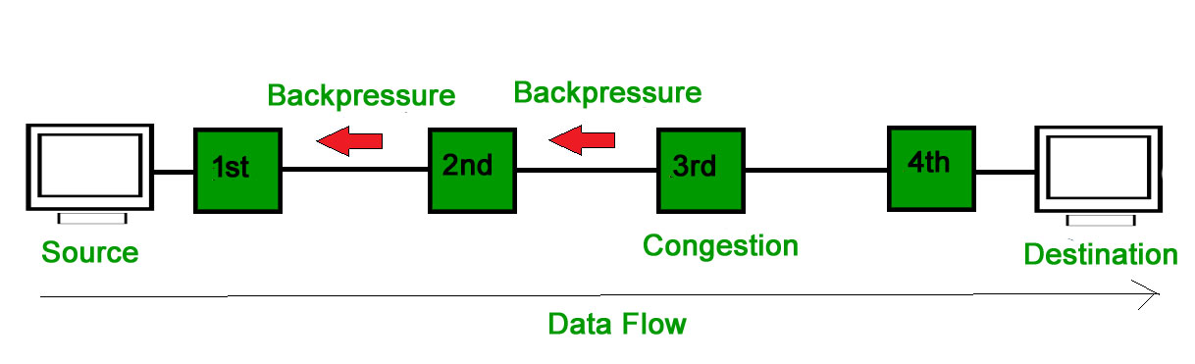
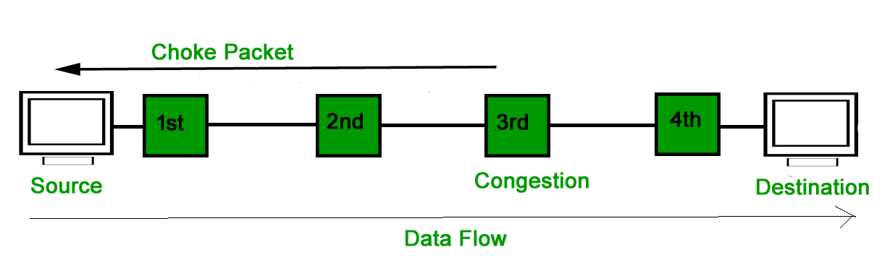
In above diagram the 3rd node is congested and stops receiving packets as a result 2nd node may be get congested due to slowing down of the output data flow. Similarly 1st node may get congested and inform the source to slow down.
2. Choke Packet Technique : Choke packet technique is applicable to both virtual networks as well as datagram subnets. A choke packet is a packet sent by a node to the source to inform it of congestion. Each router monitors its resources and the utilization at each of its output lines. Whenever the resource utilization exceeds the threshold value which is set by the administrator, the router directly sends a choke packet to the source giving it a feedback to reduce the traffic. The intermediate nodes through which the packets has traveled are not warned about congestion.

Slide 30
3. Implicit Signaling : In implicit signaling, there is no communication between the congested nodes and the source. The source guesses that there is congestion in a network. For example when sender sends several packets and there is no acknowledgment for a while, one assumption is that there is a congestion.
4. Explicit Signaling : In explicit signaling, if a node experiences congestion it can explicitly sends a packet to the source or destination to inform about congestion. The difference between choke packet and explicit signaling is that the signal is included in the packets that carry data rather than creating a different packet as in case of choke packet technique. Explicit signaling can occur in either forward or backward direction.
Forward Signaling : In forward signaling, a signal is sent in the direction of the congestion. The destination is warned about congestion. The receiver in this case adopt policies to prevent further congestion.
Backward Signaling : In backward signaling, a signal is sent in the opposite direction of the congestion. The source is warned about congestion and it needs to slow down.

Slide 31
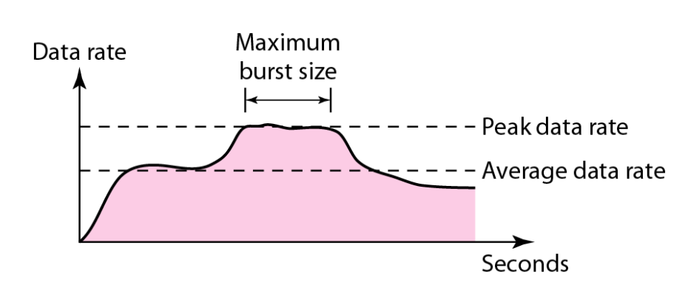

11. Explain Traffic Descriptors in DATA TRAFFIC?
The main focus of congestion control and quality of service is data traffic. In congestion control we try to avoid traffic congestion. In quality of service, we try to create an appropriate environment for the traffic.
Traffic Descriptor
Traffic descriptors are qualitative values that represent a data flow. Figure below shows a traffic flow with some of these values.

Slide 32
Average Data Rate
The average data rate is the number of bits sent during a period oftime, divided by the
number of seconds in that period. We use the following equation:
Average data rate =amount of data
time
The average data rate is a very useful characteristic of traffic because it indicates the average bandwidth needed by the traffic.
Peak Data Rate
The peak data rate defines the maximum data rate of the traffic. In Figure 24.1 it is the maximum y axis value. The peak data rate is a very important measurement because it indicates the peak bandwidth that the network needs for traffic to pass through without changing its data flow.
Maximum Burst Size : Although the peak data rate is a critical value for the network, it can usually be ignored if the duration of the peak value is very short. For example, if data are flowing steadily at the rate of 1 Mbps with a sudden peak data rate of 2 Mbps for just 1 ms, the network probably can handle the situation. However, ifthe peak data rate lasts 60 ms, there may be a problem for the network. The maximum burst size normally refers to the maximum
length of time the traffic is generated at the peak rate.

Slide 33
Effective Bandwidth
The effective bandwidth is the bandwidth that the network needs to allocate for the flow of traffic. The effective bandwidth is a function of three values: average data rate, peak data rate, and maximum burst size. The calculation of this value is very complex.
Traffic Profiles
For our purposes, a data flow can have one of the following traffic profiles: constant bit rate, variable bit rate, or bursty as shown in Figure 24.2.
Constant Bit Rate
A constant-bit-rate (CBR), or a fixed-rate, traffic model has a data rate that does not change. In this type of flow, the average data ratc and thc peak data rate are the same.
The maximum burst size is not applicable. This type of traffic is very easy for a network to handle since it is predictable. The network knows in advance how much bandwidth to allocate for this type of flow.
Variable Bit Rate
In the variable-bit-rate (VBR) category, the rate ofthe data flow changes in time, with the changes smooth instead of sudden and sharp. In this type of flow, the average data rate and the peak data rate are different. The maximum burst size is usually a small value. This type of traffic is more difficult to handle than constant-bit-rate traffic, but it
normally does not need to be reshaped.

Slide 34
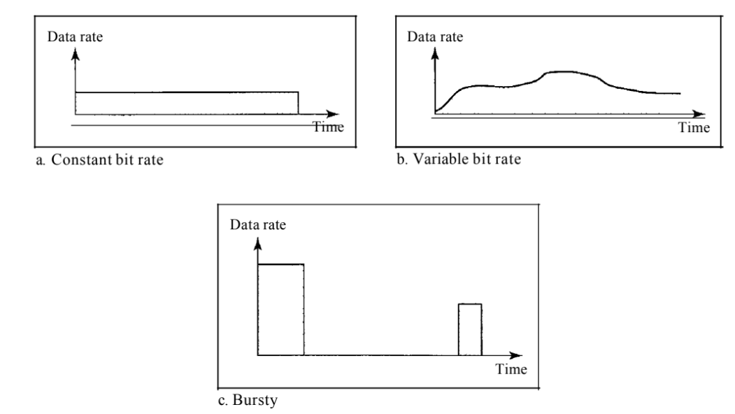
Bursty
In the bursty data category, the data rate changes suddenly in a very short time. It may jump from zero, for example, to 1 Mbps in a few microseconds and vice versa. It may also remain at this value for a while. The average bit rate and the peak bit rate are very different values in this type of flow. The maximum burst size is significant. This is the most difficult type of traffic for a network to handle because the profile is very
unpredictable. To handle this type of traffic, the network normally needs to reshape it, using reshaping techniques, as we will see shortly. Bursty traffic is one of the main causes of congestion in a network.
Three traffic profiles

